Slide 1
PROHIS
César Bonilla Garrido
Sergio Bugallo Enjamio
Marcos Cela López
Hector Rivas Pagador

Slide 2
GAME DESCRIPTION (I)
In Prohis, each player embodies a smuggler who tries to make a fortune by transporting illegal goods, a highly precarious activity since the other players have the opportunity to check your cargo or even seize it if they find suspicious items.

Slide 3
GAME DESCRIPTION (II)
Types of Cards:
Legal / Illegal Goods Cards.
Controller Cards.
Cargo Cards.

Slide 4
GAME DESCRIPTION (III)
During each turn, the player will have to do two actions:
Draw 1 or 2 cards from the deck.
Try to pass his cargo from his hand to his warehouse.

Slide 5
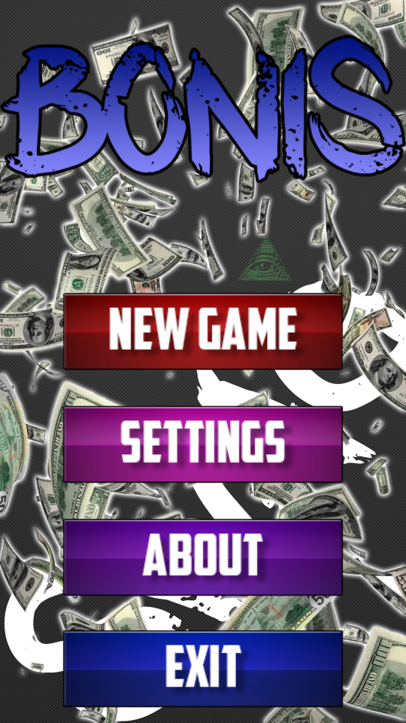
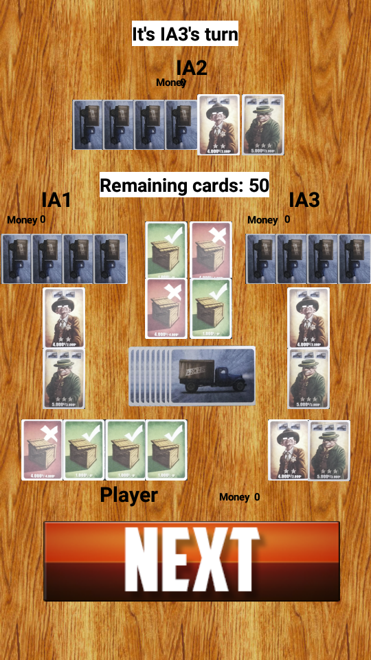
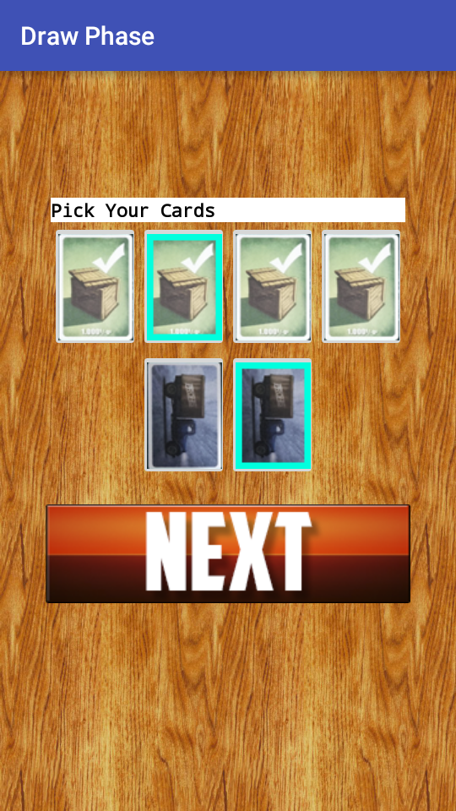
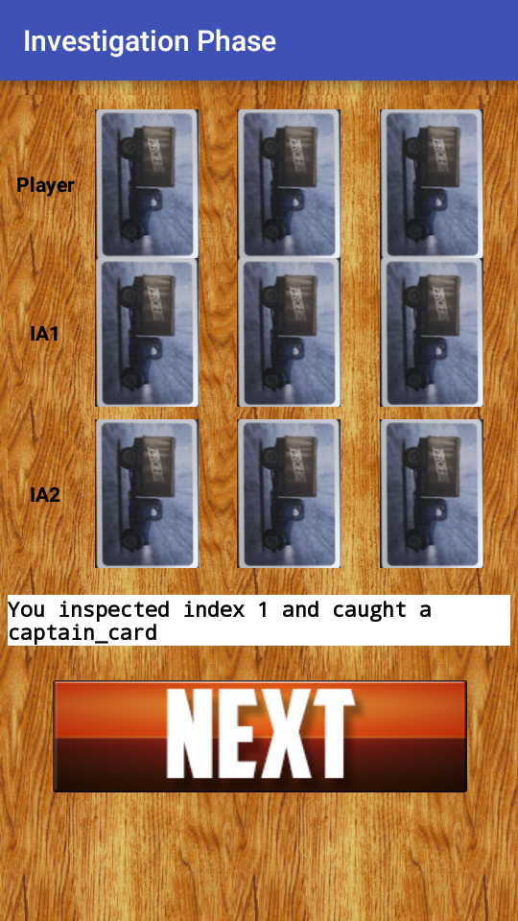
GRAPHICAL INTERFACE (I)

Slide 6
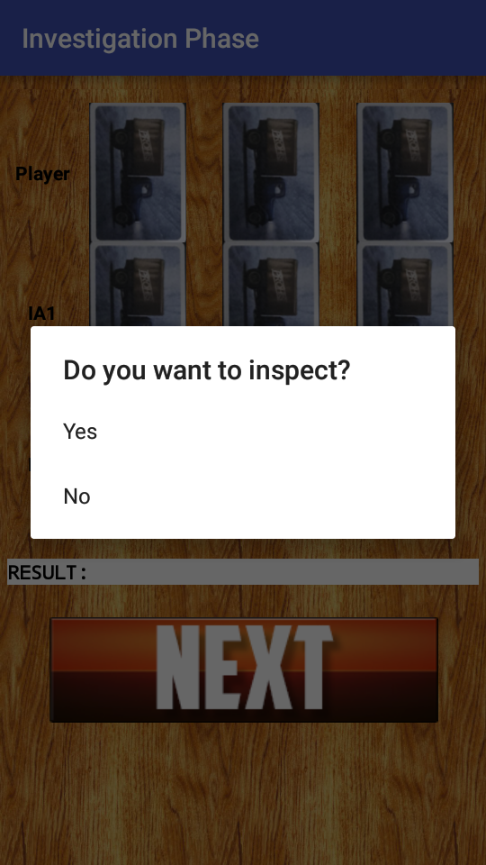
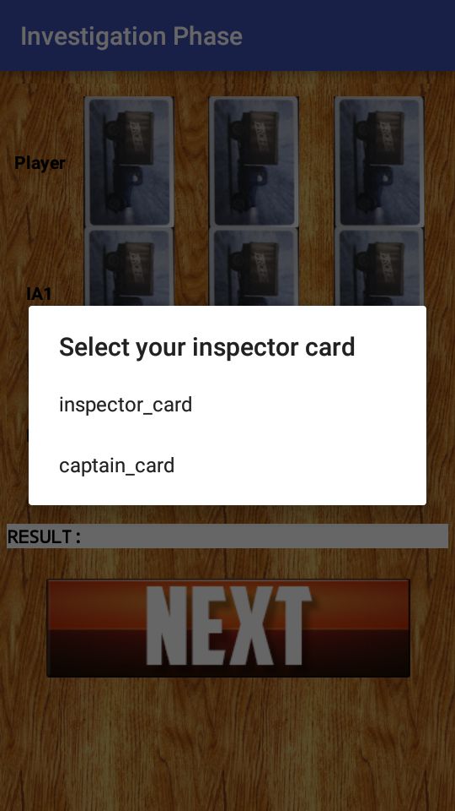
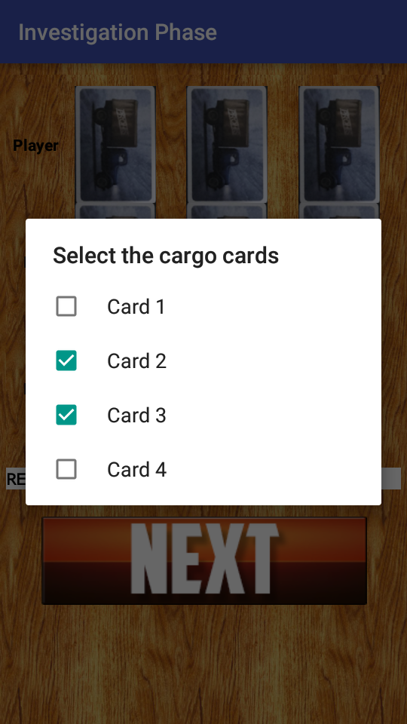
GRAPHICAL INTERFACE (II)

Slide 7
INTELLIGENT AGENTS
Cargo and Investigation Phases: Case Based Reasoning (CBR)
Draw Phase: Risk Based Algorithm

